Slide 1


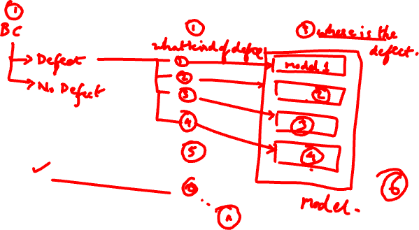
Session #11:
Image Segmentation
Dhruba Adhikary
Dhruba.a@wilp.bits-pilani.ac.in
Acknowledgement: Slide Materials adopted from - EECS 442 – David Fouhey
1

Slide 2
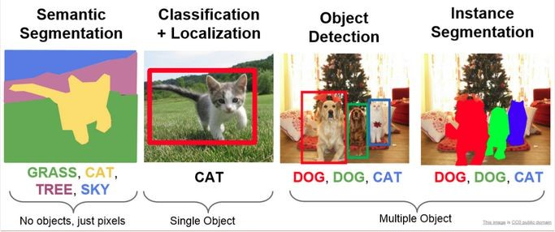
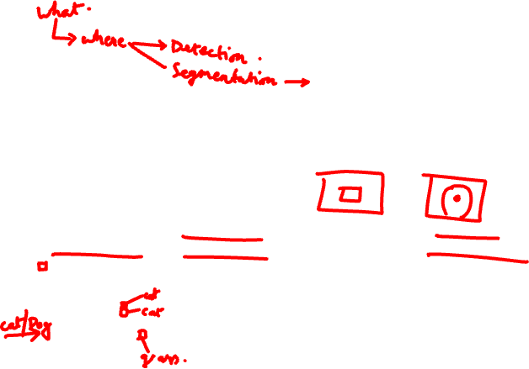
Image Segmentation
CV 11: Image Segmentation
Image segmentation is a process in computer vision that involves dividing an image into multiple segments, or regions, to simplify or change the representation of an image into something more meaningful and easier to analyze. It's often used to locate objects and boundaries within images.

Slide 3
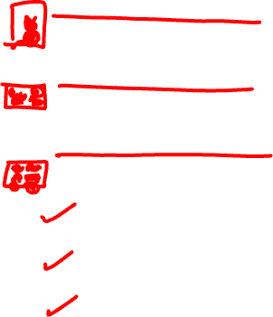
Types
CV 11: Image Segmentation
Semantic Segmentation: Assigns a label to every pixel in the image, meaning each pixel is classified as belonging to a specific object class (e.g., car, tree, road).
Instance Segmentation: Similar to semantic segmentation but differentiates between different instances of the same object class (e.g., multiple cars in an image).
Panoptic Segmentation: A combination of both semantic and instance segmentation, providing a comprehensive view by segmenting both object instances and the background.
Thresholding: Simplest form where pixels are classified based on a threshold value.
Edge-based Segmentation: Uses edges (sharp changes in intensity) to identify objects.
Region-based Segmentation: Groups pixels into regions based on some predefined criteria like color, intensity, or texture.

Slide 4
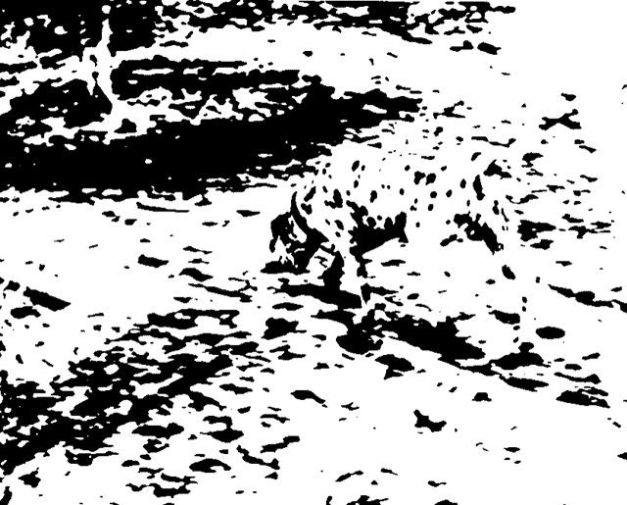
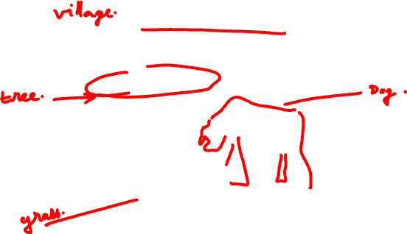
Image Segmentation
CV 11: Image Segmentation
Gestalt psychology
We perceive objects in its entirety before their individual parts

Slide 5
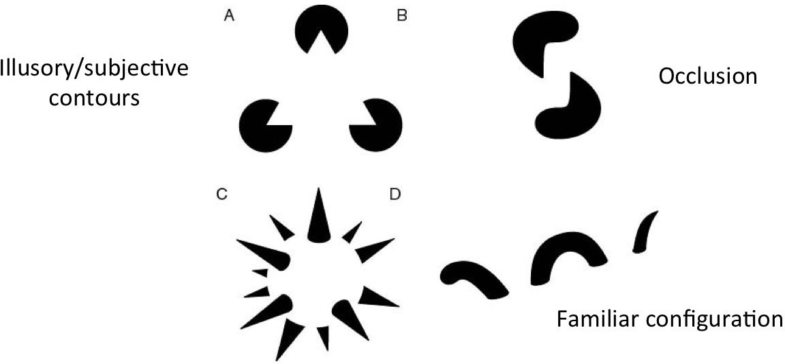
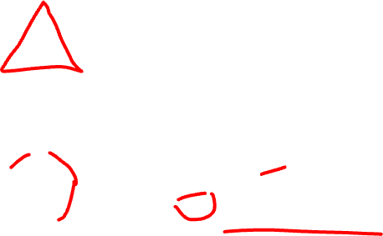
Gestalt: Seeing the unified whol^{C}e^{V 11: Image Segmentation}
https://ai.stanford.edu/~syyeung/cv web/tutorial3.html

Slide 6
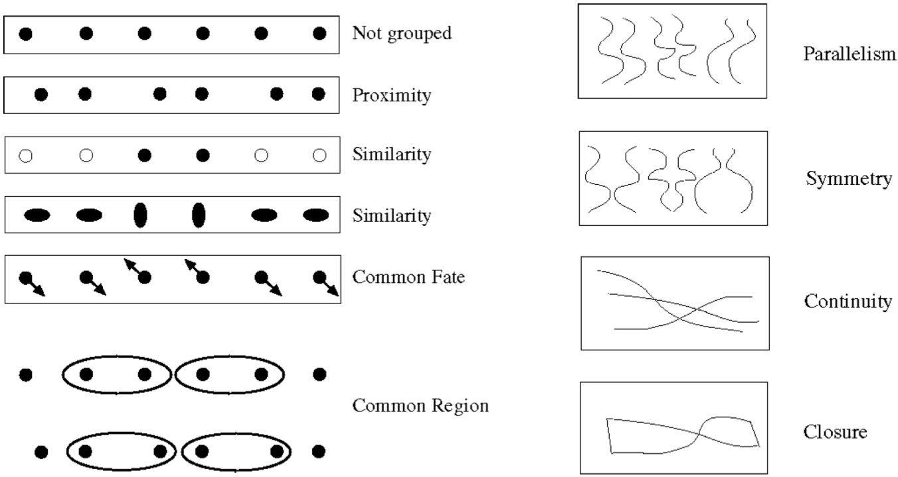

Human perception of shape rec^{C}o^{V 11}g^{: Ima}n^{ge Se}i^{gm}t^{e}i^{nta}o^{tion} n
https://ai.stanford.edu/~syyeung/cv web/tutorial3.html

Slide 7
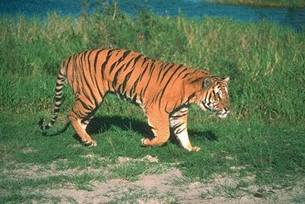
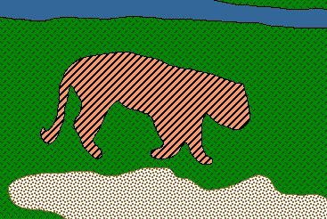
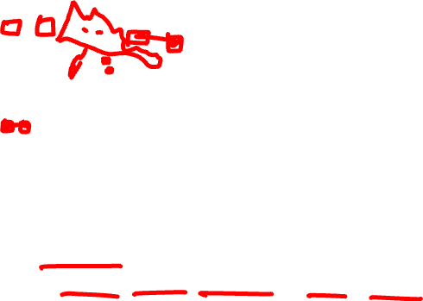
From images to objects
CV 11: Image Segmentation
What Defines an Object?
Subjective problem, but has been well-studied
Gestalt Laws seek to formalize this
proximity, similarity, continuation, closure, common fate
see notes by Steve Joordens, U. Toronto

Slide 8

Image Segmentation
CV 11: Image Segmentation
Intuitive to us
Hard to translate to algorithms
Strategies:
Top Down
Pixels belong together because they come from the same object
Bottom Up
Pixels belong together because they look similar

Slide 9

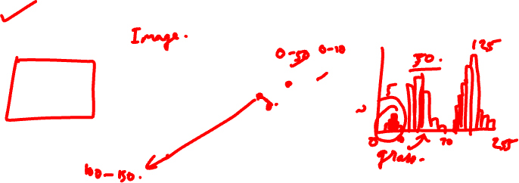
Image histograms
CV 11: Image Segmentation
How many “orange” pixels are in this image?
This type of question answered by looking at the histogram
A histogram counts the number of occurrences of each color
Given an image
The histogram is defined to be

Slide 10
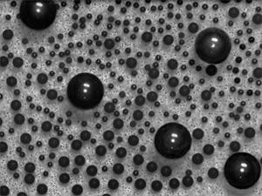
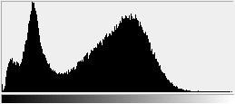
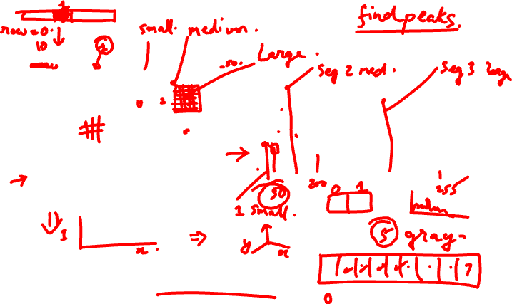
What do histograms look like?
CV 11: Image Segmentation
How Many Modes Are There?
Easy to see, hard to compute

Slide 11
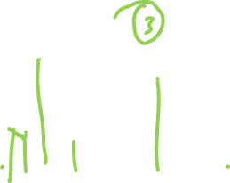
Histogram-based segmentation^{CV 11: Image Segmentation}
Goal
Break the image into K regions (segments)
Solve this by reducing the number of colors to K and mapping each pixel to the closest color
– photoshop demo

Slide 12
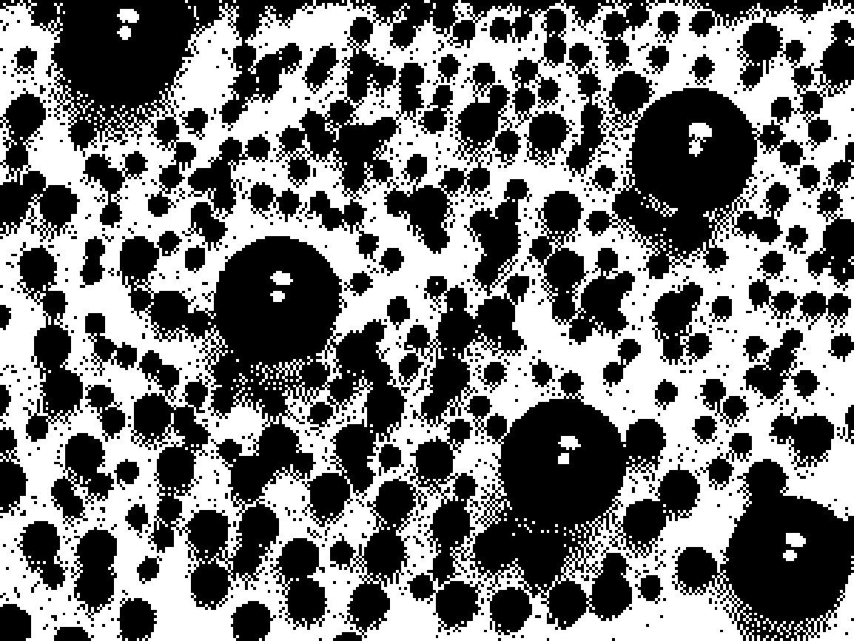
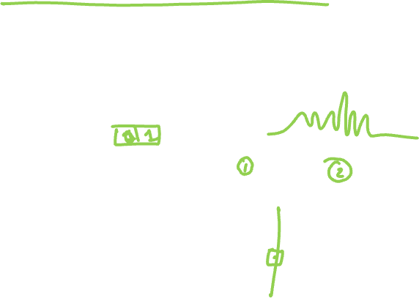
Histogram-based segmentation^{CV 11: Image Segmentation}
Goal
Break the image into K regions (segments)
Solve this by reducing the number of colors to K and mapping each pixel to the closest color
– photoshop demo
Here’s what it looks like if we use two colors

Slide 13



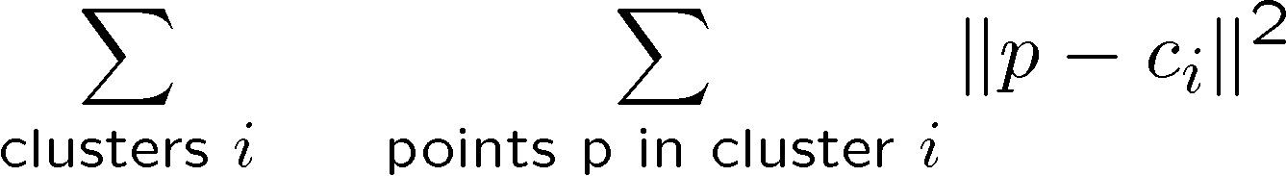
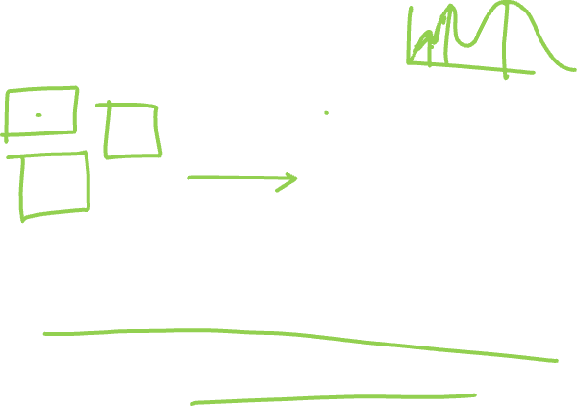
Clustering
CV 11: Image Segmentation
How to choose the representative colors?
This is a clustering problem!
G G
R R
Objective
Each point should be as close as possible to a cluster center
– Minimize sum squared distance of each point to closest center

Slide 14

Break it down into subproblems^{CV 11: Image Segmentation}
Suppose I tell you the cluster centers c_{i}
Q: how to determine which points to associate with each c_{i}?
A: for each point p, choose closest c_{i}
Suppose I tell you the points in each cluster
Q: how to determine the cluster centers?
A: choose c_{i} to be the mean of all points in the cluster

Slide 15

K-means clustering
CV 11: Image Segmentation
K-means clustering algorithm
Randomly initialize the cluster centers, c₁, ..., c_{K}
Given cluster centers, determine points in each cluster
For each point p, find the closest c_{i}. Put p into cluster i
Given points in each cluster, solve for c_{i}
Set c_{i} to be the mean of points in cluster i
If c_{i} have changed, repeat Step 2
Demo:
https://ai.stanford.edu/~syyeung/cvweb/tutorial3.html
Properties
Will always converge to some solution
Can be a “local minimum”
does not always find the global minimum of objective function:

Slide 16
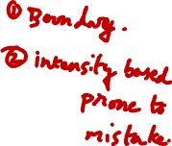

Slide 17
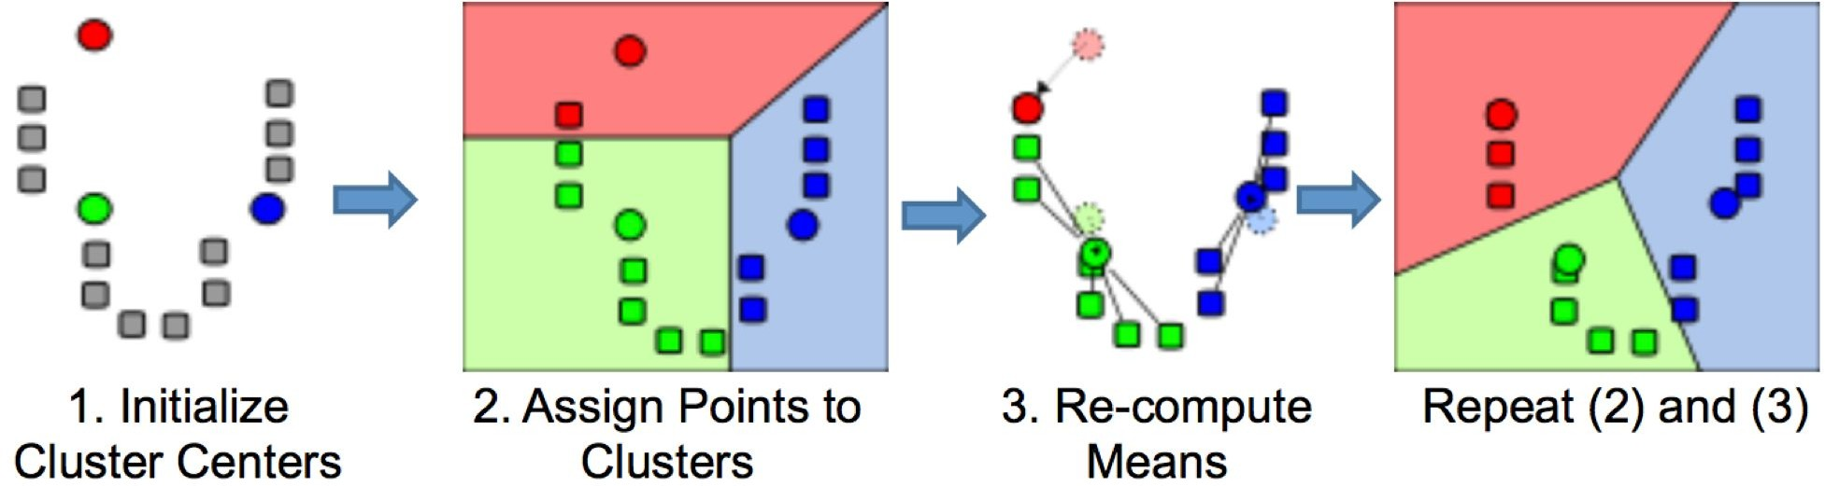
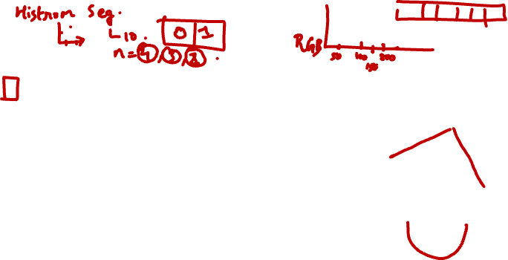
K means clustering
CV 11: Image Segmentation

Slide 18
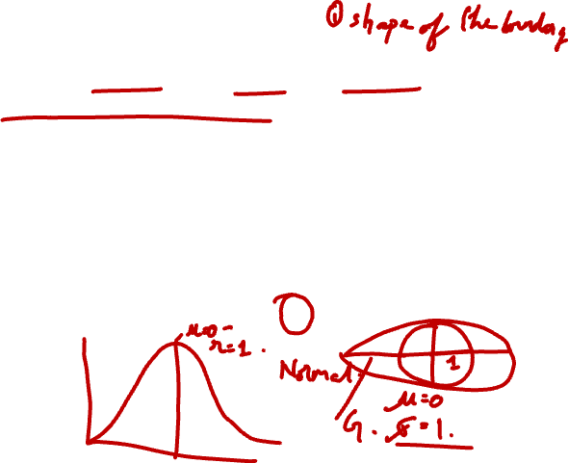
Probabilistic clustering
CV 11: Image Segmentation
Basic questions
what’s the probability that a point x is in cluster m?
what’s the shape of each cluster?
K-means doesn’t answer these questions
Basic idea
instead of treating the data as a bunch of points, assume that they are all generated by sampling a continuous function
This function is called a generative model
– defined by a vector of parameters θ

Slide 19



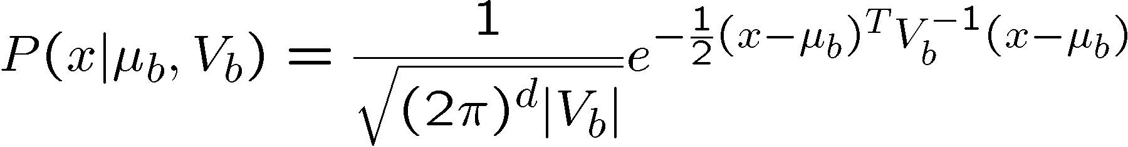

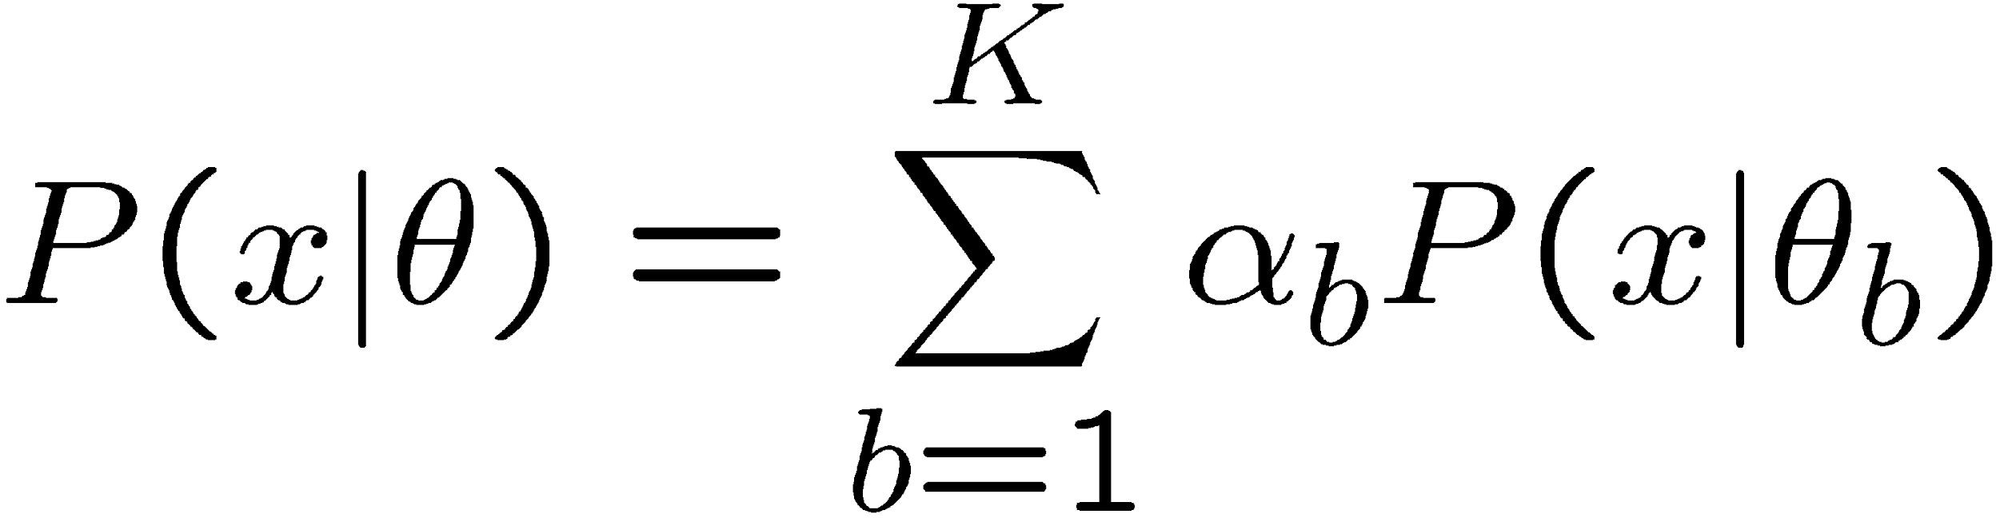
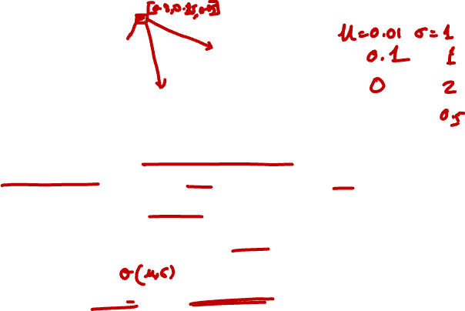
Mixture of Gaussians
CV 11: Image Segmentation
One generative model is a mixture of Gaussians (MOG)
K Gaussian blobs with means μ_{b} covariance matrices V_{b}, dimension d – blob b defined by:
blob b is selected with probability
the likelihood of observing x is a weighted mixture of Gaussians
where
Notes:
Of course. Here is a detailed step-by-step explanation of probabilistic clustering for image segmentation using the Expectation-Maximization (EM) algorithm, based on the provided slides.
## What is Probabilistic Clustering?
Unlike algorithms like K-means that assign each data point to a single cluster (a "hard" assignment), probabilistic clustering provides a more nuanced, "soft" assignment. It addresses two key questions that K-means doesn't:
What's the probability that a point x belongs to a specific cluster m? It calculates a probability distribution over the clusters for each point.
What is the shape of each cluster? It can model clusters with different shapes and orientations (e.g., circles, ellipses).
The core idea is to treat the data not just as a collection of points, but as points sampled from an underlying probability distribution. This distribution is defined by a generative model, which is described by a set of parameters, θ.
## The Generative Model: Mixture of Gaussians (MoG)
A very common generative model for clustering is the Mixture of Gaussians (MoG). In this model, we assume the data is generated from a mix of several different Gaussian (or Normal) distributions. In the context of image segmentation, each pixel is a data point.
The model is defined by:
K Gaussian "blobs": Each blob represents a cluster.
Mean μb​: The center of blob b.
Covariance Matrix Vb​: Describes the shape, size, and orientation of blob b. A diagonal covariance matrix results in an axis-aligned ellipse, while a full covariance matrix can model any elliptical shape.
Mixing Coefficient αb​: The probability of selecting a point from blob b. The sum of all mixing coefficients must be 1 (∑b=1K​αb​=1).
The probability of observing a single data point x is a weighted sum of its probability under each Gaussian blob:
P(x∣θ)=b=1∑K​αb​P(x∣μb​,Vb​)
where P(x∣μb​,Vb​) is the standard multivariate Gaussian probability density function. The goal is to find the parameters θ=[μ1​,...,μK​,V1​,...,VK​,α1​,...,αK​] that best fit the data.
## The Goal & Approach: Expectation-Maximization (EM)
The objective is to find the model parameters θ that maximize the likelihood of observing our entire dataset. The likelihood function is the product of the probabilities of all N data points (pixels) in the image:
P(data∣θ)=i=1∏N​P(xi​∣θ)
Finding the optimal θ directly is mathematically complex. Therefore, we use an iterative algorithm called Expectation-Maximization (EM). EM alternates between two steps until the parameters converge.
Initialization: Start with an initial random guess for the parameters θ (the means, covariances, and mixing coefficients of the blobs).
E-Step (Expectation): Given the current guess for the parameters, compute the "ownership" probability for each point.
M-Step (Maximization): Given the ownership probabilities, update the model parameters to better fit the data.
Repeat: Loop through the E and M steps until the parameters stop changing significantly.
## The EM Algorithm: Step-by-Step
Let's break down the two main steps of the algorithm.
1. The E-Step (Expectation)
In this step, we calculate the "responsibility" or "ownership" that each blob b has for each data point xi​. This is the posterior probability P(b∣xi​,θ) that point xi​ belongs to blob b, given our current model parameters. We use Bayes' theorem for this calculation:
P(b∣xi​,μb​,Vb​)=∑k=1K​αk​P(xi​∣μk​,Vk​)αb​P(xi​∣μb​,Vb​)​
Numerator: The probability of selecting blob b (αb​) times the probability of seeing point xi​ if it came from blob b (P(xi​∣μb​,Vb​)).
Denominator: A normalization factor that sums the numerator over all possible blobs. This ensures the ownership probabilities for a single point xi​ sum to 1.
We compute this value for every point xi​ and every blob b.
2. The M-Step (Maximization)
In this step, we use the ownership probabilities calculated in the E-step to update the parameters of each blob. The new parameters are calculated to maximize the data likelihood.
Update Mixing Coefficient (αbnew​): The new mixing coefficient for blob b is the average ownership of that blob across all N data points.
αbnew​=N1​i=1∑N​P(b∣xi​,μb​,Vb​)
Update Mean (μbnew​): The new mean for blob b is a weighted average of all data points, where the weight for each point xi​ is its probability of belonging to blob b.
μbnew​=∑i=1N​P(b∣xi​,μb​,Vb​)∑i=1N​xi​P(b∣xi​,μb​,Vb​)​
Update Covariance (Vbnew​): The new covariance matrix for blob b is a weighted average of the covariances of each point, again weighted by ownership probabilities.
Vbnew​=∑i=1N​P(b∣xi​,μb​,Vb​)∑i=1N​(xi​−μbnew​)(xi​−μbnew​)TP(b∣xi​,μb​,Vb​)​
After the M-step, we have a new set of parameters θnew, and we repeat the process by going back to the E-step. This iterative process is guaranteed to increase the data likelihood at each step until it converges to a local maximum.
For image segmentation, once the algorithm has converged, each pixel can be assigned to the cluster (blob) for which it has the highest ownership probability, resulting in a segmented image.

Slide 20
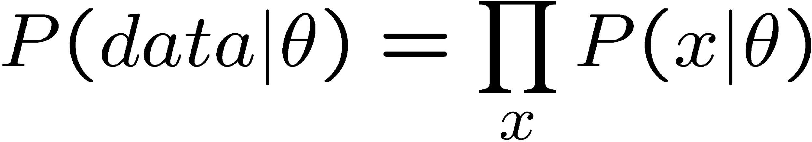
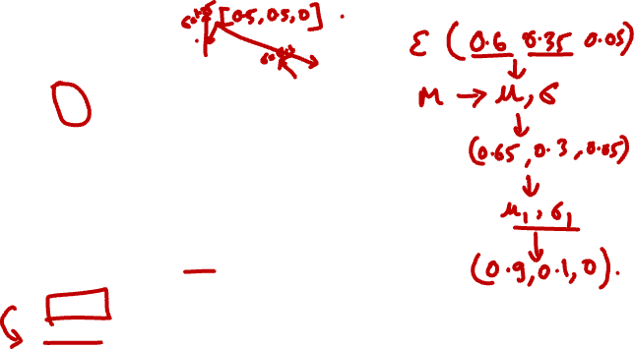
Expectation maximization (EM) ^{CV 11: Image Segmentation}
Goal
find blob parameters θ that maximize the likelihood function:
Approach:
E step: given current guess of blobs, compute ownership of each point
M step: given ownership probabilities, update blobs to maximize likelihood function
repeat until convergence

Slide 21
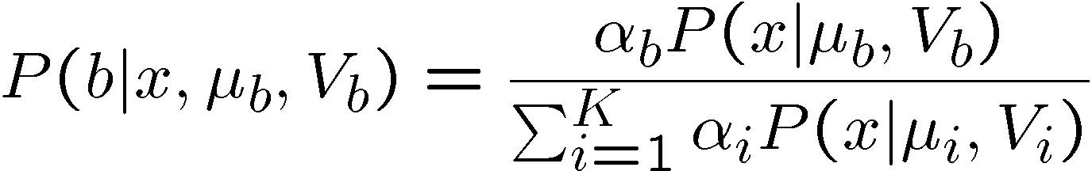
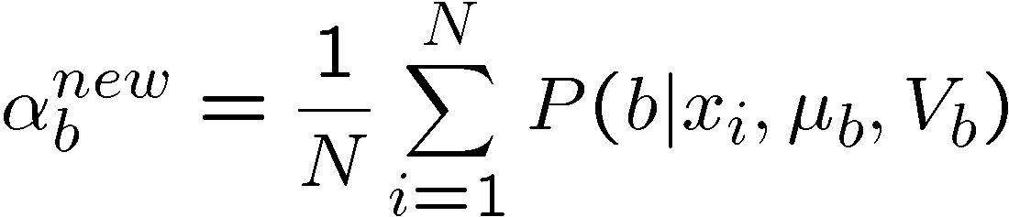
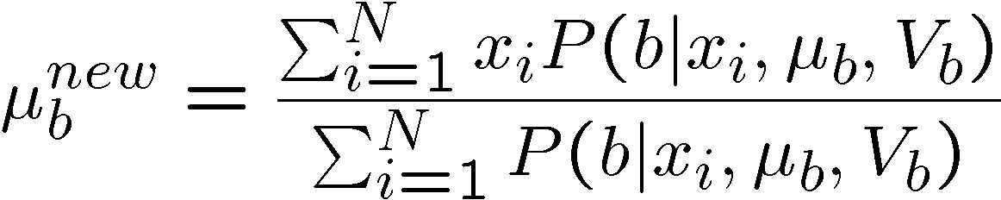
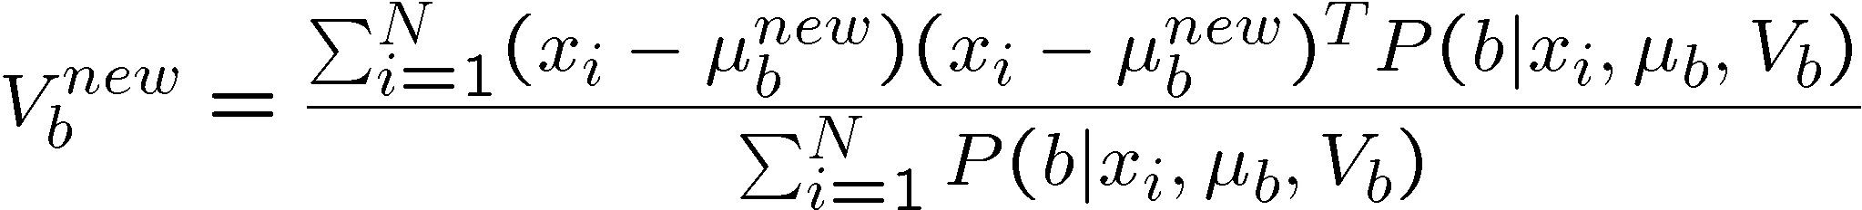
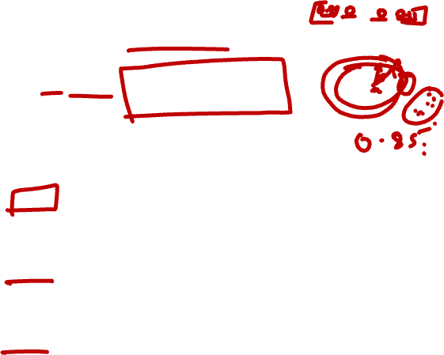
EM details
CV 11: Image Segmentation
E-step
compute probability that point x is in blob i, given current guess of θ
M-step
compute probability that blob b is selected
N data points
mean of blob b
covariance of blob b

Slide 22
EM demos
CV 11: Image Segmentation
https://github.com/annoviko/pyclustering

Slide 23
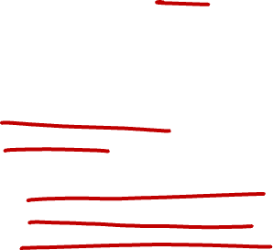
Applications of EM
CV 11: Image Segmentation
Turns out this is useful for all sorts of problems
any clustering problem
any model estimation problem
missing data problems
finding outliers
segmentation problems
segmentation based on color
segmentation based on motion
foreground/background separation
...

Slide 24
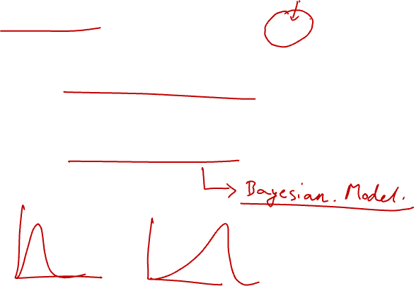
Problems with EM
CV 11: Image Segmentation
Local minima
Need to know number of segments Need to choose generative model

Slide 25
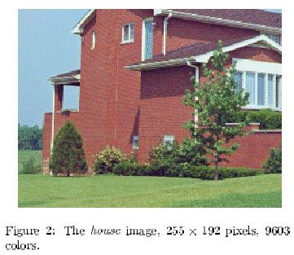
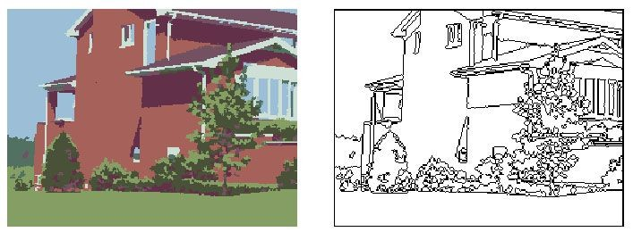
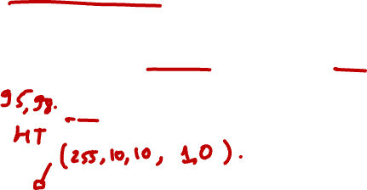
Mean-shift for image segmentat^{C}i^{V} o^{11: Im}n^{age Segmentation}
Useful to take into account spatial information
instead of (R, G, B), run in (R, G, B, x, y) space
D. Comaniciu, P. Meer, Mean shift analysis and applications, 7th International Conference on Computer Vision, Kerkyra, Greece, September 1999, 1197-1203.
– http://www.caip.rutgers.edu/riul/research/papers/pdf/spatmsft.pdf
More Examples:
http://www.caip.rutgers.edu/~comanici/segm_images.html

Slide 26
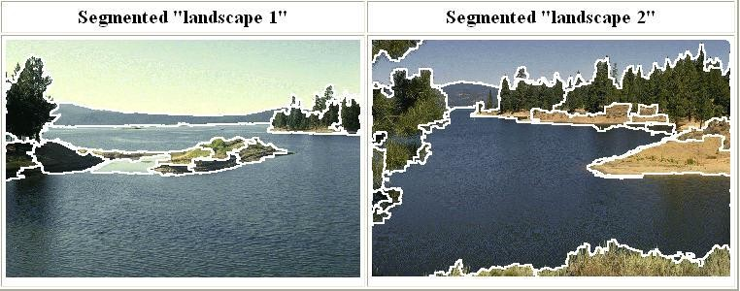
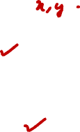
Mean shift segmentation
CV 11: Image Segmentation
D. Comaniciu and P. Meer, Mean Shift: A Robust Approach toward Feature Space Analysis, PAMI 2002.
Versatile technique for clustering-based segmentation

Slide 27
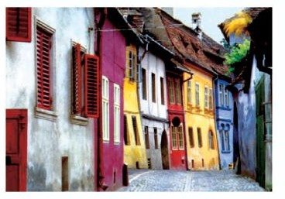
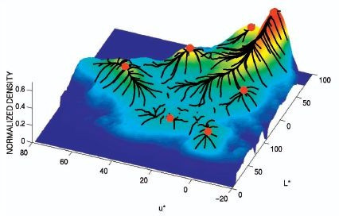
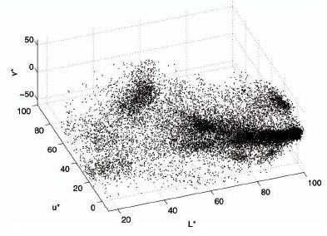
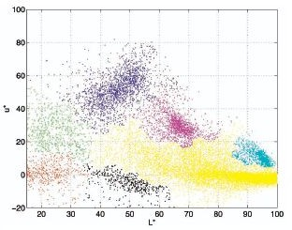
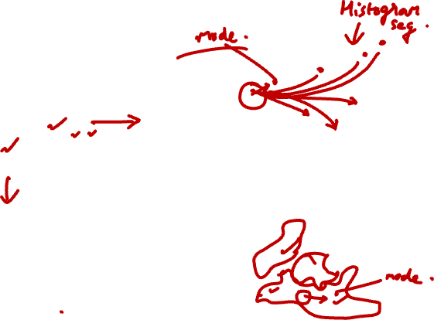
Mean shift algorithm
CV 11: Image Segmentation
Try to find modes of this non-parametric density

Slide 28


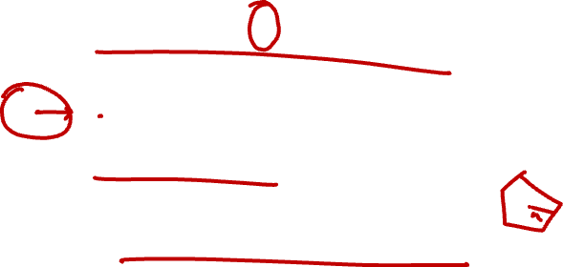
Kernel density estimation
CV 11: Image Segmentation
Kernel density estimation function
Gaussian kernel

Slide 29






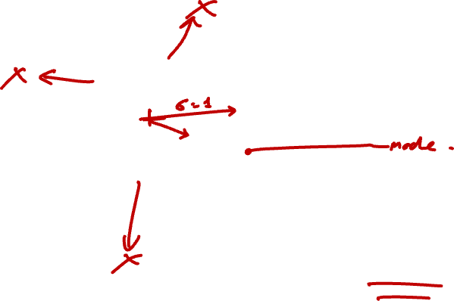
Mean shift
CV 11: Image Segmentation
Region of interest
Center of mass
Mean Shift vector
Slide by Y. Ukrainitz & B. Sarel

Slide 30
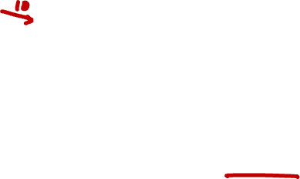
Mean shift
CV 11: Image Segmentation
Region of interest
Center of mass
Mean Shift vector
Slide by Y. Ukrainitz & B. Sarel

Slide 31
Mean shift
CV 11: Image Segmentation
Region of interest
Center of mass
Mean Shift vector
Slide by Y. Ukrainitz & B. Sarel

Slide 32
Mean shift
CV 11: Image Segmentation
Region of interest
Center of mass
Mean Shift vector
Slide by Y. Ukrainitz & B. Sarel

Slide 33

Mean shift
CV 11: Image Segmentation
Region of interest
Center of mass
Mean Shift vector
Slide by Y. Ukrainitz & B. Sarel

Slide 34
Mean shift
CV 11: Image Segmentation
Region of interest
Center of mass
Mean Shift vector
Slide by Y. Ukrainitz & B. Sarel

Slide 35

Mean shift
CV 11: Image Segmentation
Region of interest
Center of mass
Slide by Y. Ukrainitz & B. Sarel

Slide 36





Computing the Mean Shift
CV 11: Image Segmentation
Simple Mean Shift procedure:
Compute mean shift vector
Translate the Kernel window by m(x)
Slide by Y. Ukrainitz & B. Sarel

Slide 37



Real Modality Analysis
CV 11: Image Segmentation

Slide 38



Attraction basin
CV 11: Image Segmentation
Attraction basin: the region for which all trajectories lead to the same mode
Cluster: all data points in the attraction basin of a mode
Slide by Y. Ukrainitz & B. Sarel

Slide 39


Attraction basin
CV 11: Image Segmentation

Slide 40


Finding Modes in a Histogram
CV 11: Image Segmentation
How Many Modes Are There?
Easy to see, hard to compute

Slide 41


Mean Shift [Comaniciu & Meer]
CV 11: Image Segmentation
Iterative Mode Search
Initialize random seed, and window W
Calculate center of gravity (the “mean”) of W:
Translate the search window to the mean
Repeat Step 2 until convergence

Slide 42


Mean-Shift
CV 11: Image Segmentation
Approach
Initialize a window around each point
See where it shifts—this determines which segment it’s in
Multiple points will shift to the same segment

Slide 43

Mean shift clustering
CV 11: Image Segmentation
The mean shift algorithm seeks modes of the given set of points
Choose kernel and bandwidth
For each point:
Center a window on that point
Compute the mean of the data in the search window
Center the search window at the new mean location
Repeat (b,c) until convergence
Assign points that lead to nearby modes to the same cluster

Slide 44




Mean shift segmentation results
CV 11: Image Segmentation
http://www.caip.rutgers.edu/~comanici/MSPAMI/msPamiResults.html

Slide 45
CV 11: Image Segmentation
http://www.caip.rutgers.edu/~comanici/MSPAMI/msPamiResults.html

Slide 46

Mean-shift: other issues
CV 11: Image Segmentation
Speedups
Binned estimation
Fast search of neighbors
Update each window in each iteration (faster convergence)
Other tricks
Use kNN to determine window sizes adaptively
Lots of theoretical support
D. Comaniciu and P. Meer, Mean Shift: A Robust Approach toward Feature Space Analysis, PAMI 2002.

Slide 47

Mean shift pros and cons
CV 11: Image Segmentation
Pros
Good general-practice segmentation
Flexible in number and shape of regions
Robust to outliers
Cons
Have to choose kernel size in advance
Not suitable for high-dimensional features
When to use it
Oversegmentatoin
Multiple segmentations
Tracking, clustering, filtering applications

